Slide 1
Partnership Proposal Presentation
ChadaTech
Quarter / Month Year
Presented by
William Paddock
Full Name 2
ChadaTech
April
2026

Slide 2

Waterfall Model
1
Requirements
2
Dessign
3
Development
4
Testing
5
5
Deploying
6
5
6
Maintenance
ChadaTech
April
2026

Slide 3
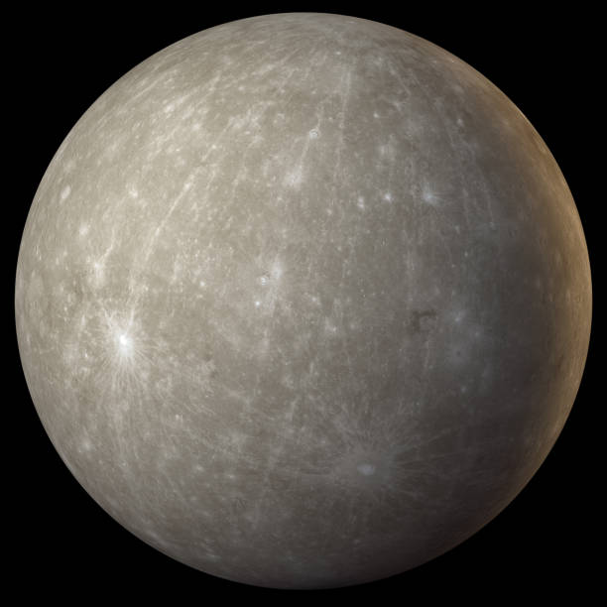
Explaining Waterfall Modal
Features of the Waterfall Model
Waterfall method takes a sequential approach, thus
PLanning Phase for the team, also meet with customer create full design
Development build the product here to complete, no beta tests.
Testers place tests on top of this design.
Beta Testing and Alpha Testing here
Final Product has been released here.
Then let customer check to see if there are any errors.
Unable to add in new features after planning phase, This would have been an issue when switching to detox views. Also accepting or changing plans after the initial build would be difficult from the rigid structure.
ChadaTech
April
2026

Slide 4
Agile Roles
1
Scrum Master
2
Product Owner
3
Tester
4
Development
5
6
ChadaTech
April
2026

Slide 5
Components of Scrum
Scrum Master
Product Owner
Scrum Team
Coaches teamin self-managed and cross-functionality.
Creates measures for definition of done
Influences removal of Implements to the scrum team.
Makes sure scrums stay within expected time box and are productive.
Helps find effective techniques for effective product backlog.
Helps with Scrum Adoption.
Develops the product goals
Creas and communicated the products backlog.
Orders the product backlog items
Ensures the product backlog is transparent and visible.
Helps explain the customer's point of view and process with designing the product.
Develops the product
Fills in the jira tickets for responses
Created the product documentation
Investigates bugs from the testers.
Tests the product to clean out bugs.
ChadaTech
April
2026

Slide 6

Explaining Agile Phases
Concept
Create ideas with the entire team, product owner,
Scrum master and testers.
Building high level success criteria.
Not a full specification, but instead a lightweight charter.
Project charter, initial KPI’s, feasibility assessment, go/no-go decision.
Keep initial requirements minimal.
ChadaTech
April
2026

Slide 7

Explaining Agile Phases
Inception
Create a plan from the concept.
building a team that comes together.
Identifying skill gaps,
Making sure to brainstorm with stakeholders.
Review ambiguities before development begins
Assemble team,
initial Backlog,
user stories,
design mockup,
sprint zero setup.
ChadaTech
April
2026

Slide 8

Explaining Agile Phases
Iteration
Start building the first iteration of development.
Run a planning session
Select backlog items to complete
Autame tests to run on each commit
Defects are caught fixed - ideally.
Frequent code commits
Daily standups to keep the team synchronized
Remove any surface blockers
Sprint ends with the product review with stakeholders.
Tools: GitHub (version control), Jenkins (CI/CD), Postman (API testing), Cypress or Selenium (end-to-end testing), SonarQube (code quality).
Outputs: Working software increment, updated backlog, sprint retrospective findings.
ChadaTech
April
2026

Slide 9
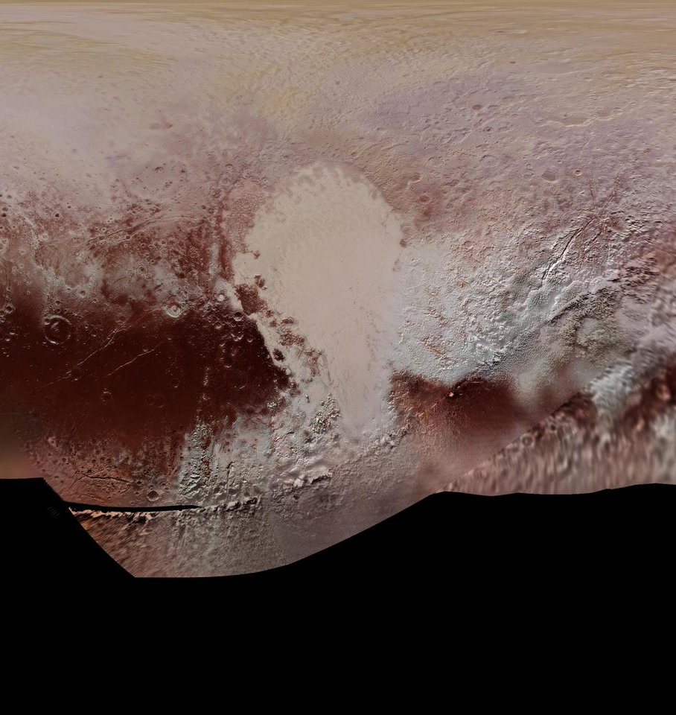
Explaining Agile Phases
Release
Release stage for bridges between development and production.
Team has built something worth shipping
Dedicated QA cycle runs thorough testing without issue
User Acceptance Testing (UAT) clears
Critical defects get resolved before launch
Documentation release notes and user training manuals are finished.
Stabilize deployment plans and rollback plans.
Initial soft launch or beta test with a pilot group is common
Outputs: Production release, deployment documentation, UAT sign-off, rollback plan.
ChadaTech
April
2026

Slide 10
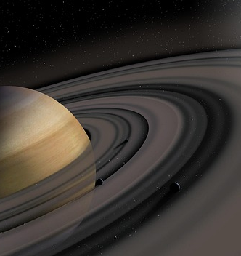
Explaining Agile Phases
Maintenance
Real World feedback starts, maintenance of the product.
Monitoring tools used to review the updatime, error rates and performance metrics in real time.
Created bugs are addressed as well as hotfixed handled
Minor issues accumulate in the backlog for future interactions.
User Feedback from support tickets, surveys and analytics feeds are used.
Tools: Sentry, Grafana, Azure Monitor, New Relic, customer feedback channels.
Outputs: Bug fixes, performance improvements, updated backlog, next iteration planning.
ChadaTech
April
2026

Slide 11

Explaining Agile Phases
Retirement
Product eventually reaches the point where it no longer functions.
Running new program that will eventually take over at the same time for zero down time.
ChadaTech
April
2026

Slide 12
Agile VS Waterfall
Agile Method
Waterfall Method
Projects that are likely to change or have unclear variables work excellent here. Agile is defined by being able handle unknown variables. Such as when the project requirements change often.
A suggested consideration here would be application design, where users may expect different things depending on who and how its used.
When the project is generally static, has a clear beginning middle and end. These static projects are defined well in the beginning and have clear budgets and resources given.
This is suggested for Large Static projects in which the system is setup and then expected to only run one way. An example may be Electric lines for the electrical company.
ChadaTech
April
2026

Slide 13
Works Cited
Scrum.org. (2019). Home. Scrum.org. https://www.scrum.org/
Nehra, M. (2022, May 11). 6 Stages of the Agile Development Lifecycle. Www.decipherzone.com. https://www.decipherzone.com/blog-detail/agile-development-lifecycle
GeeksforGeeks. (2018, March 18). Waterfall Model Software Engineering. GeeksforGeeks. https://www.geeksforgeeks.org/software-engineering/waterfall-model/
What Are the Disadvantages of Agile? (n.d.). Kanban Software for Agile Project Management. https://businessmap.io/blog/agile-disadvantages
Johnivan, J. R. (2024, November 25). Agile vs. Waterfall | Software Development Methodologies. Project-Management.com. https://project-management.com/agile-vs-waterfall/
Company Name
Quarter Month
Year

